Slide 1
DBAS27198
Group Project
GROUP 7 (Hai & Kai)
The Hai Nguyen - 991745555
Malachi Bampoe - 991734540

Slide 2
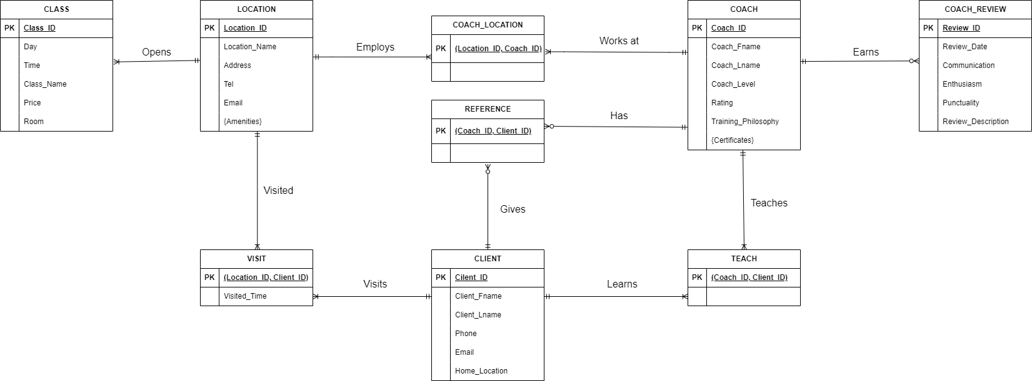
ER Diagram

Slide 3
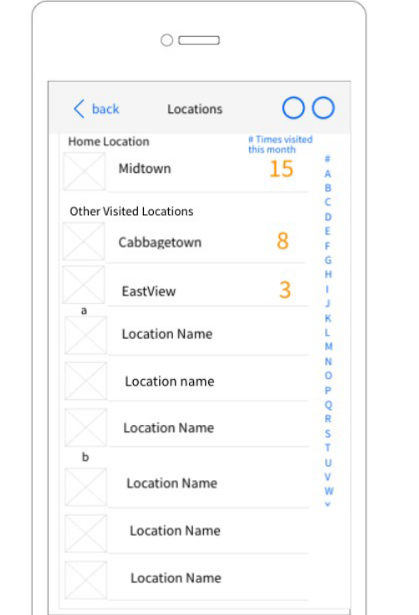
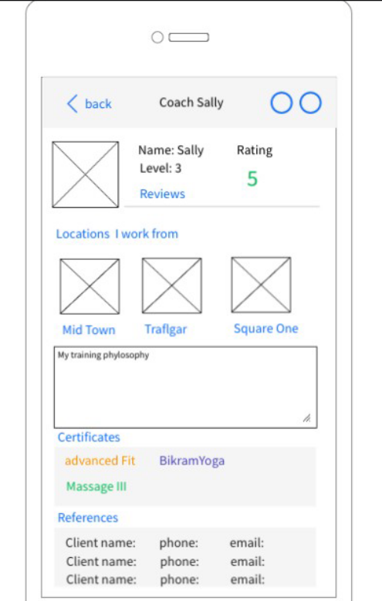
Wireframe 1 Wireframe 5

Slide 4
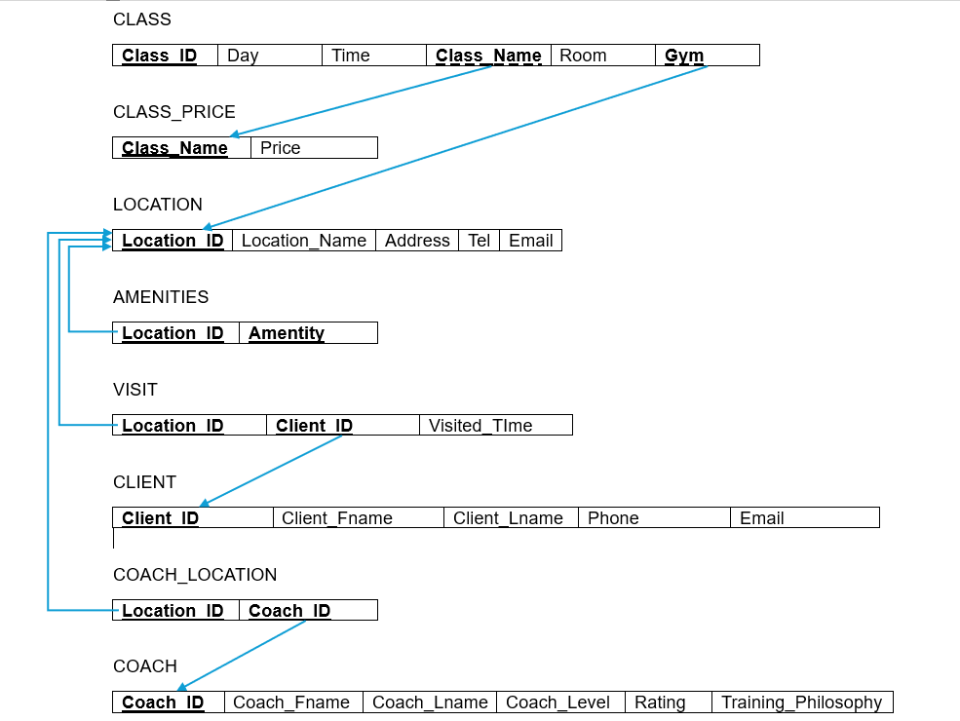
Relational Model: CLASS-LOCATION-COACH

Slide 5
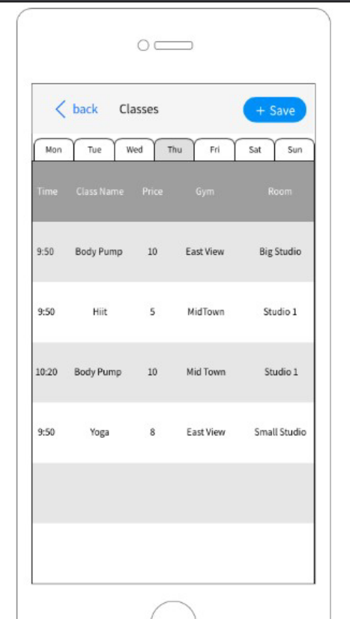
Wireframe 6

Slide 6
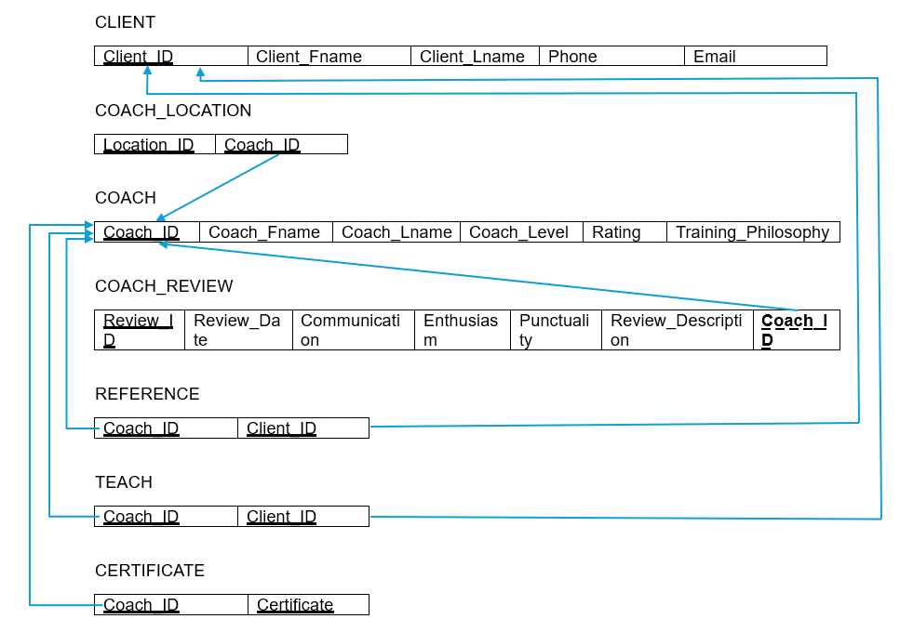
Relational Model: CLIENT-COACH

Slide 7
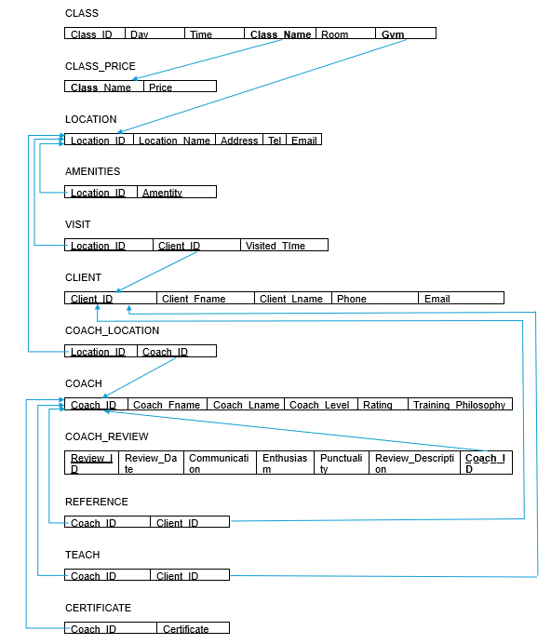
Relational Model: Complete Diagram

Slide 8
Table/Row Creation (Location & Class_Price)
Table Creation Query (Location)
CREATE TABLE LOCATION (
Location_ID INT PRIMARY KEY,
Location_Name VARCHAR(50) NOT NULL,
Address VARCHAR(100) NOT NULL,
Tel VARCHAR(10),
Email VARCHAR(30)
);
Row Insertion Query (Location)
INSERT INTO LOCATION VALUES ( 1, 'Midtown', '7897 McLaughlin Brampton, Ontario, Canada', '2899466376', 'nguytheh@sheridancollege.ca' );
Table Creation Query (Class_Price)
CREATE TABLE CLASS_PRICE (
Class_Name VARCHAR(20) PRIMARY KEY,
Price INT
);
Row Insertion Query (Class_Price)
INSERT INTO CLASS_PRICE VALUES (
'Hiit', 5
);

Slide 9
Table/Row Creation (Class & Client)
Table Creation Query (Class)
CREATE TABLE CLASS (
Class_ID INT PRIMARY KEY,
Day VARCHAR(10) NOT NULL,
Time TIME NOT NULL,
Class_Name VARCHAR(20),
Gym INT,
Room VARCHAR(20),
FOREIGN KEY (Class_Name)
REFERENCES CLASS_PRICE (Class_Name),
FOREIGN KEY (Gym)
REFERENCES LOCATION (Location_ID)
);
Row Insertion Query (Class)
INSERT INTO CLASS VALUES (
1, 'Thursday', '9:50', 'Hiit', 1, 'Studio1'
);
Table Creation Query (Client)
CREATE TABLE CLIENT (
Client_ID INT PRIMARY KEY,
Client_Fname VARCHAR(50),
Client_Lname VARCHAR(50),
Phone VARCHAR(10),
Email VARCHAR(100),
Home_Location INT,
FOREIGN KEY (Home_Location) REFERENCES LOCATION (Location_ID)
);
Row Insertion Query (Client)
INSERT INTO CLIENT VALUES (
1, 'The Hai', 'Nguyen', '2899866376', 'nguytheh@sheridancollege.ca', 1
);

Slide 10
Table/Row Creation (Amenities & Visit)
Table Creation Query (Amenities)
CREATE TABLE AMENITIES (
Location_ID INT NOT NULL,
Amenity VARCHAR(20) NOT NULL,
PRIMARY KEY (Location_ID, Amenity),
FOREIGN KEY (Location_ID) REFERENCES LOCATION (Location_ID)
);
Row Insertion Query (Amenities)
INSERT INTO AMENITIES VALUES (
1, 'Pool'
);
Table Creation Query (Visit)
CREATE TABLE VISIT (
Location_ID INT NOT NULL,
Client_ID INT NOT NULL,
Visited_Time INT CHECK (Visited_Time >= 0),
PRIMARY KEY (Location_ID, Client_ID),
FOREIGN KEY (Location_ID) REFERENCES LOCATION (Location_ID),
FOREIGN KEY (Client_ID) REFERENCES CLIENT (Client_ID)
);
Row Insertion Query (Visit)
INSERT INTO VISIT VALUES (
1, 1, 15
);

Slide 11
Table/Row Creation (Coach & Coach_Review)
Table Creation Query (Coach)
CREATE TABLE COACH (
Coach_ID INT PRIMARY KEY,
Coach_Fname VARCHAR(50),
Coach_Lname VARCHAR(50),
Coach_Level INT CHECK (Coach_Level BETWEEN 1 AND 5),
Rating INT CHECK (Rating BETWEEN 1 AND 5),
Training_Philosophy VARCHAR(300)
);
Row Insertion Query (Coach)
INSERT INTO COACH VALUES (
1, 'Sally', 'Afam', 3, 5, 'Gym is the best'
);
Table Creation Query (Coach_Review)
CREATE TABLE COACH_REVIEW ( Review_ID INT PRIMARY KEY,
Review_Date DATE NOT NULL,
Communication INT NOT NULL CHECK (Communication BETWEEN 1 AND 5),
Enthusiasm INT NOT NULL CHECK (Enthusiasm BETWEEN 1 AND 5),
Punctuality INT NOT NULL CHECK (Punctuality BETWEEN 1 AND 5),
Review_Description VARCHAR(300),
Coach_ID INT,
FOREIGN KEY (Coach_ID) REFERENCES COACH (Coach_ID)
);
Row Insertion Query (Coach_Review)
INSERT INTO COACH_REVIEW VALUES (
1, '2024-03-30', 3, 4, 3, 'Sally is really a good coach', 1);

Slide 12
Table/Row Creation (Coach_Location & Reference)
Table Creation Query (Coach_Location)
CREATE TABLE COACH_LOCATION (
Coach_ID INT NOT NULL,
Location_ID INT NOT NULL,
PRIMARY KEY(Coach_ID, Location_ID),
FOREIGN KEY (Coach_ID) REFERENCES COACH (Coach_ID),
FOREIGN KEY (Location_ID) REFERENCES LOCATION (Location_ID)
);
Row Insertion Query (Coach_Location)
INSERT INTO COACH_LOCATION VALUES (
1,1
);
Table Creation Query (Reference)
CREATE TABLE REFERENCE (
Coach_ID INT NOT NULL,
Client_ID INT NOT NULL,
PRIMARY KEY(Coach_ID, Client_ID),
FOREIGN KEY (Coach_ID) REFERENCES COACH (Coach_ID),
FOREIGN KEY (Client_ID) REFERENCES CLIENT (Client_ID)
);
Row Insertion Query (Reference)
INSERT INTO REFERENCE VALUES (
1, 1
);

Slide 13
Table/Row Creation (Teach & Certificate)
Table Creation Query (Teach)
CREATE TABLE TEACH (
Coach_ID INT NOT NULL,
Client_ID INT NOT NULL,
PRIMARY KEY (Coach_ID, Client_ID),
FOREIGN KEY (Coach_ID) REFERENCES COACH (Coach_ID),
FOREIGN KEY (Client_ID) REFERENCES CLIENT (Client_ID)
);
Row Insertion Query (Teach)
INSERT INTO TEACH VALUES (
1, 1
);
Table Creation Query (Certificate)
CREATE TABLE CERTIFICATE (
Coach_ID INT NOT NULL,
Certificate VARCHAR(50) NOT NULL,
PRIMARY KEY (Coach_ID, Certificate),
FOREIGN KEY (Coach_ID) REFERENCES COACH (Coach_ID),
);
Row Insertion Query (Certificate)
INSERT INTO CERTIFICATE VALUES (
1, 'advanced Fit'
);

Slide 14
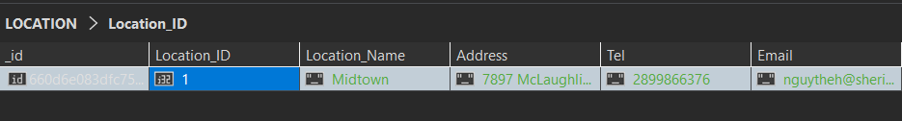
NoSQL Queries (Location)
db.createCollection("LOCATION");
db.LOCATION.insertOne({Location_ID: 1, Location_Name: "Midtown",
Address: "7897 McLaughlin Brampton, Ontario, Canada",
Tel: "2899866376", Email: "nguytheh@sheridancollege.ca"});
RESULT:

Slide 15
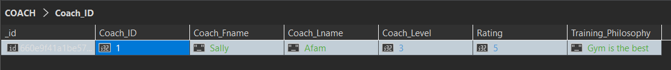
NoSQL Queries (Coach)
db.createCollection("COACH");
db.COACH.insertOne({Coach_ID: 1, Coach_Fname: "Sally", Coach_Lname: "Afam",
Coach_Level: 3, Rating: 5, Training_Philosophy: "Gym is the best"});
RESULT:

Slide 16
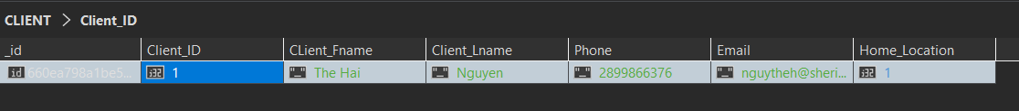
NoSQL Queries (Client)
db.createCollection("CLIENT");
db.CLIENT.insertOne({Client_ID: 1, CLient_Fname: "The Hai", Client_Lname: "Nguyen",
Phone: "2899466376", Email: "nguytheh@sheridancollege.ca",
Home_Location: 1});
RESULT:

Slide 17
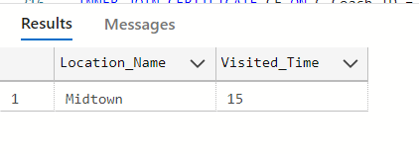
Select Statements (Wireframe 1)
SELECT L.Location_Name, V.Visited_Time
FROM LOCATION L
INNER JOIN VISIT V ON L.Location_ID = V.Location_ID
WHERE V.Client_ID = 1;
TABLE:

Slide 18
Select Statements (Wireframe 2)
SELECT L.Location_Name, L.Address, L.Tel, L.Email, A.Amenity, C.Coach_Fname
FROM LOCATION L
INNER JOIN AMENITIES A ON L.Location_ID = A.Location_ID
INNER JOIN COACH_LOCATION CL ON L.Location_ID = CL.Location_ID
INNER JOIN COACH C ON CL.Coach_ID = C.Coach_ID
WHERE L.Location_ID = 1;
RESULT:

Slide 19
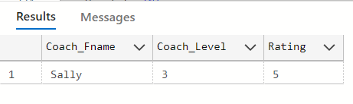
Select Statements (Wireframe 3)
SELECT Coach_Fname, Coach_Level, Rating
FROM COACH;
RESULT:

Slide 20
Select Statements (Wireframe 4(Query))
SELECT C.Coach_Fname, C.Coach_Level, C.Rating, L.Location_Name, C.Training_Philosophy, CE.Certificate, CONCAT(CT.Client_Fname,' ', CT.CLient_Lname) AS 'Client name', CT.Phone, CT.Email
FROM COACH C
INNER JOIN COACH_LOCATION CL ON C.Coach_ID = CL.Coach_ID
INNER JOIN LOCATION L ON CL.Location_ID = L.Location_ID
INNER JOIN CERTIFICATE CE ON C.Coach_ID = CE.Coach_ID
INNER JOIN REFERENCE R ON C.Coach_ID = R.Coach_ID
INNER JOIN CLIENT CT ON R.Client_ID = CT.Client_ID
WHERE C.Coach_ID = 1;

Slide 21
Select Statements (Wireframe 4(RESULT))
RESULT:

Slide 22
THANK YOU FOR LISTENING!

